Slide 1





AUTOMATED ATTENDANCE SYSTEM USING FACE RECOGNITION

Slide 2

TABLE OF CONTENTS
1️⃣ Introduction
2️⃣ Objectives
3️⃣ Modules
4️⃣ Source Code
5️⃣ Output
6️⃣ Challenges Faced
7️⃣ Conclusion

Slide 3
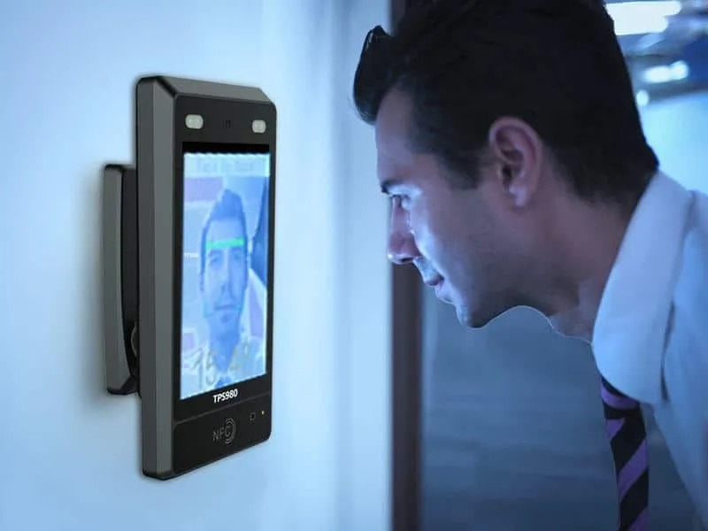
INTRODUCTION
The Automated Attendance System Using Face Recognition detects and marks attendance in real-time, reducing manual effort and errors.
The system stores data in a excel sheet and sends email alerts to students when they are marked absent.
Users can also set specific time slots for attendance recording, ensuring a flexible and accurate tracking process.

Slide 4
OBJECTIVES
1.Automate Attendance Marking in Real-Time -
Utilize face recognition to detect and record student attendance automatically.
2.Improve Accuracy & Prevent Proxy Attendance -
Ensure only registered students are marked present, reducing fraudulent attendance.
3.Integrate Attendance Data with Excel -
Store and update attendance records in an Excel file for future reference and analysis.
4.Send Automated Email Alerts to Absentees-
Notify students via email when they are marked absent, ensuring accountability.
5.Enhance Usability with Keyboard Controls
Provide options to display attendance ('d') and exit the system ('q') for smooth user interaction.

Slide 5
MODULES
Modules Used in Face Recognition Attendance System:
face_recognition – Detects and verifies faces.
cv2 (OpenCV) – Captures video and processes images.
numpy (np) – Handles calculations for face recognition.
pandas (pd) – Stores and manages attendance data.
os – Manages files and paths.
datetime – Records date and time for attendance.
smtplib & email – Sends absence alerts via email.

Slide 6
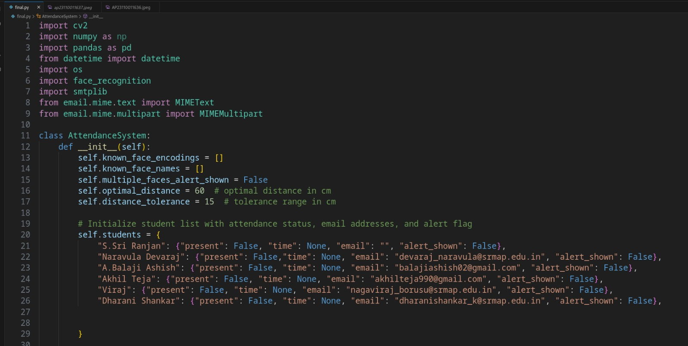
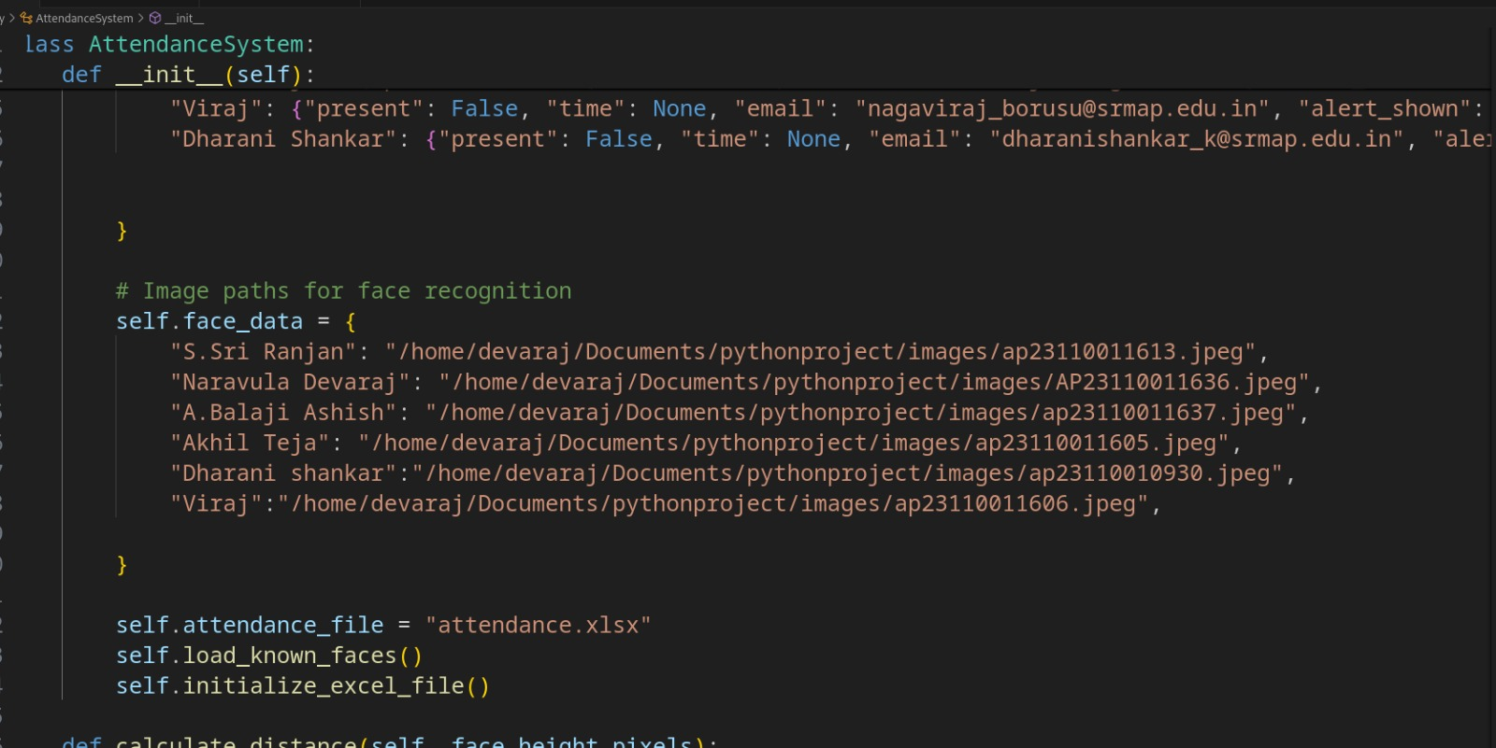
SOURCE CODE
1. Initialization & Setup

Slide 7
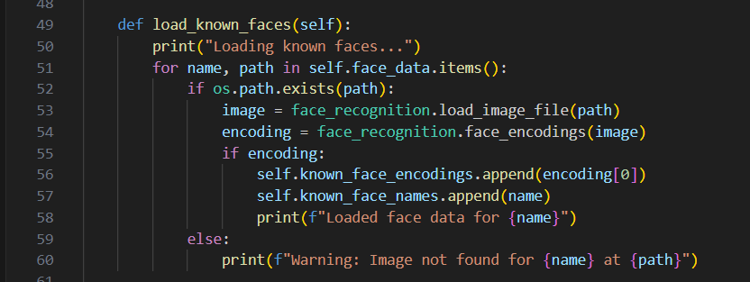
2. Loading Known Faces

Slide 8
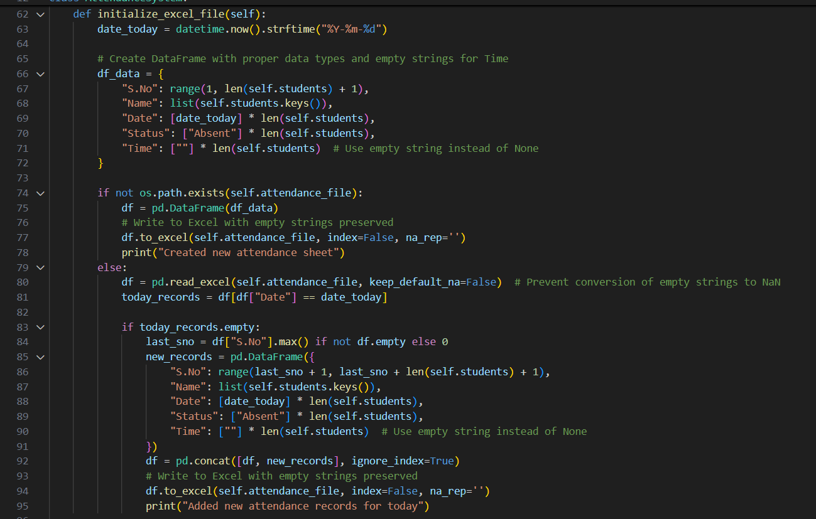
3. INITIALIZING THE ATTENDANCE EXCEL FILE

Slide 9
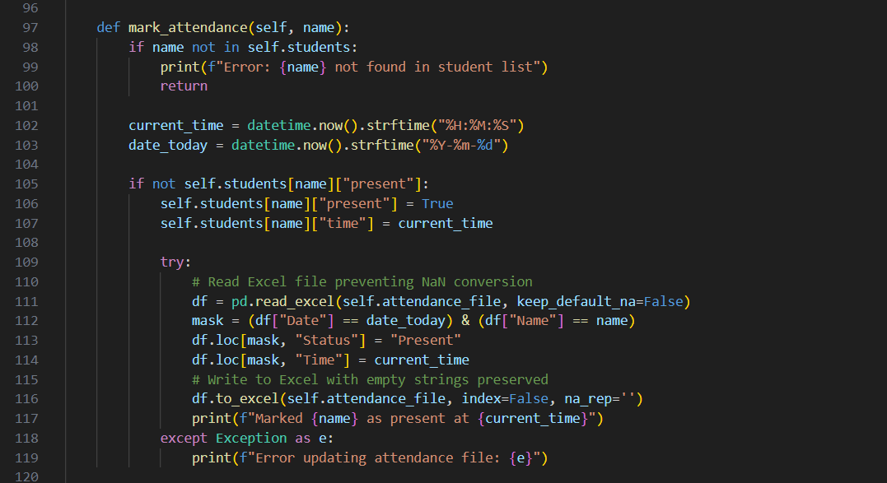
4. Marking Attendance

Slide 10
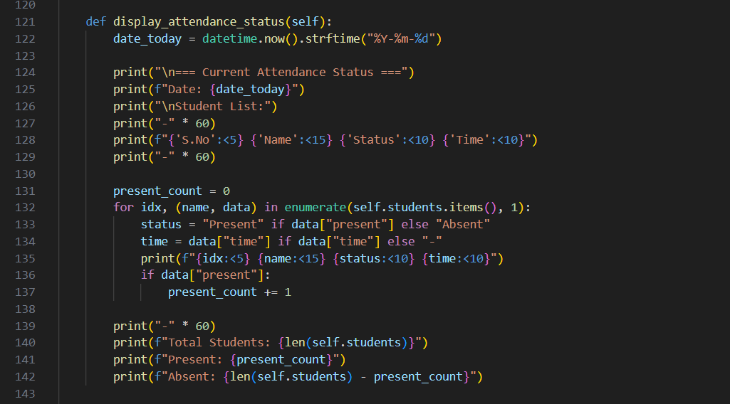
5. Displaying Attendance Status

Slide 11
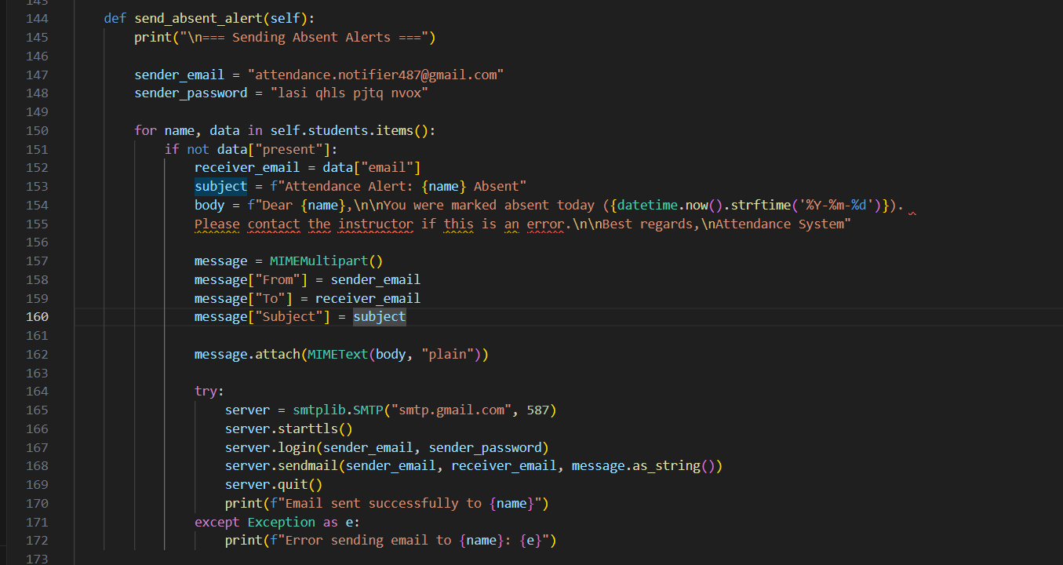
6. Sending Absent Alerts via Email

Slide 12
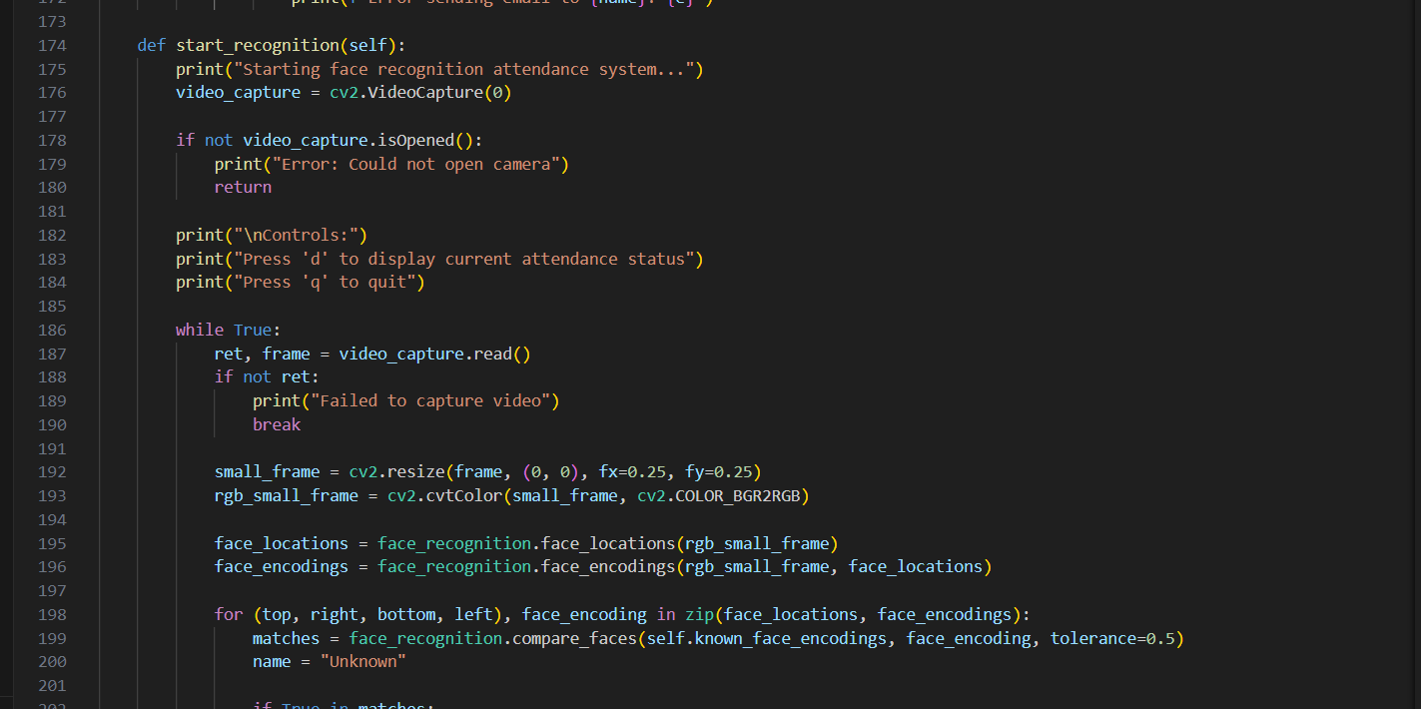
7. Face Recognition & Real-Time Attendance

Slide 13
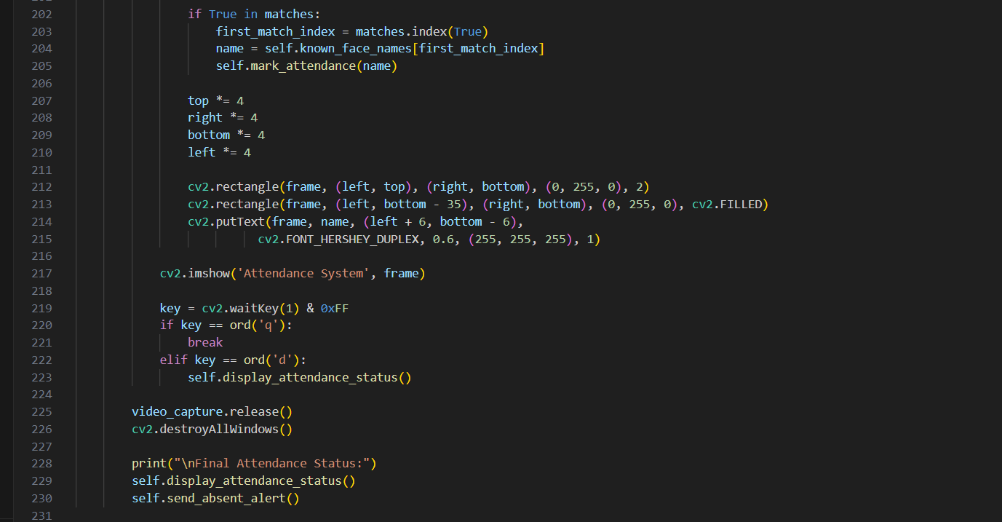
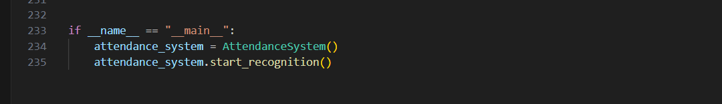
8. Running the Program

Slide 14
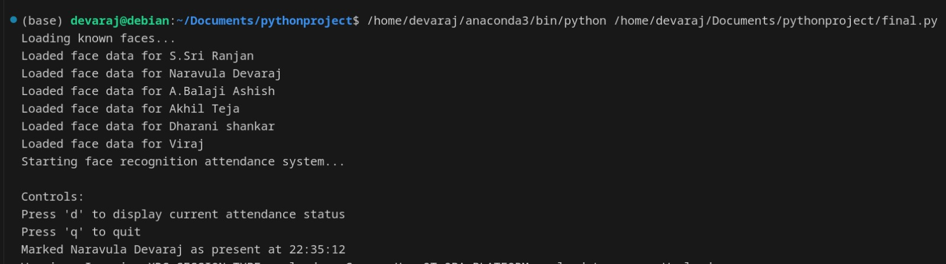
OUTPUT

Slide 15
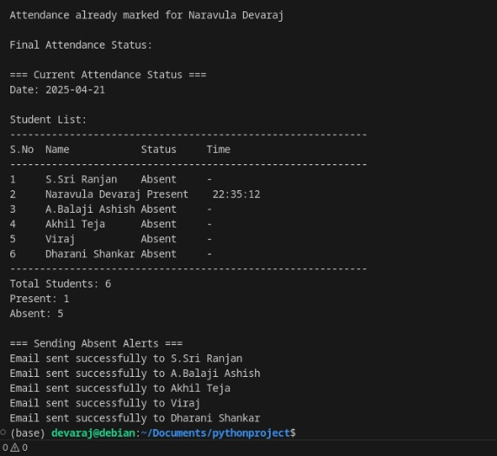
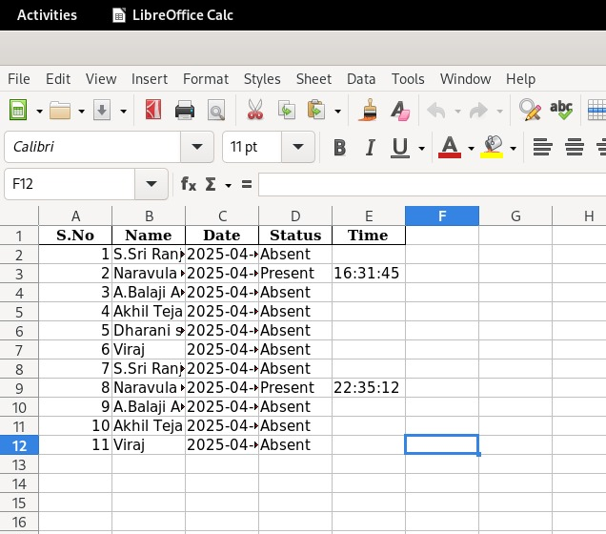

Slide 16
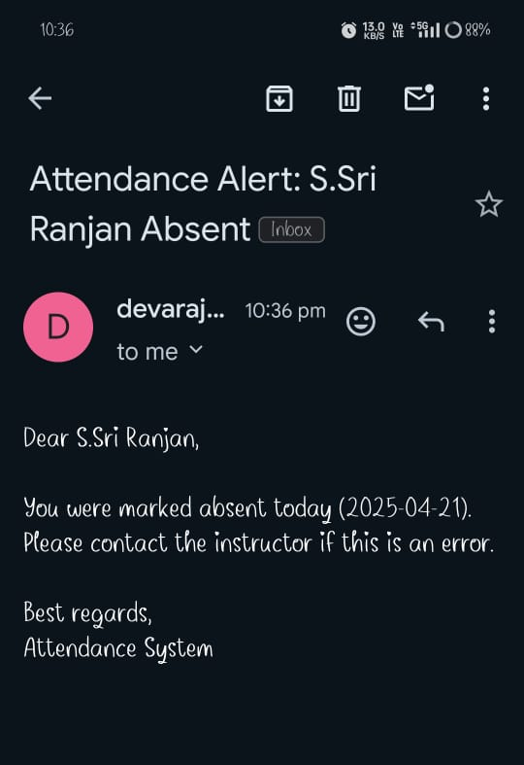
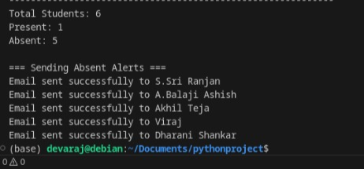

Slide 17
CHALLENGES FACED
1.Handling Unknown Faces
Problem: The system marked some unknown persons as known due to incorrect matches.
Solution: Set a confidence threshold and only accepted a match if it was above a certain similarity score.
2.Face Recognition Accuracy Issues
Problem:The system sometimes misidentifies faces or fails to detect them due to lighting conditions, face angles, or low-quality images.
Solution: Improved accuracy by using high-resolution images, proper lighting, and capturing multiple images for each person to train the model better

Slide 18
CHALLENGES FACED
3.Duplicate Attendance Entries
Problem:
The system sometimes records a student's attendance multiple times for the same day, causing data redundancy and errors.
Solution:
To prevent duplicate entries, the system checks if an attendance record for the student on that date already exists before adding a new one. This is done by implementing a validation mechanism in the code or enforcing a unique constraint in the database.

Slide 19
CONCLUSION
The Face Recognition-Based Attendance System makes attendance tracking faster, easier, and more accurate. By using a camera and facial recognition, it automatically identifies students and marks their attendance in real time.
Key Benefits:
✅ Saves Time – No need for manual attendance marking.
✅ More Accurate – Reduces errors and prevents proxy attendance.
✅ Automatic Records – Stores attendance in an Excel sheet for easy tracking.
✅ Email Alerts – Sends notifications to absent students.
This system is efficient, reliable, and scalable, making it a great solution for schools, colleges, and offices. In the future, it can be improved with better face detection, mobile integration, and cloud storage.

Slide 20
THANK
you
Team Members:
Naravula Devaraj AP23110011636
S .Sri Ranjan Reddy AP23110011613
B. Naga Viraj AP23110011606
P .Lokesh Ram AP23110011628

